Slide 1
Does digital learning work?
Evidence of its impact on learning outcomes
Michael Carrier
Highdale Learning

Slide 2
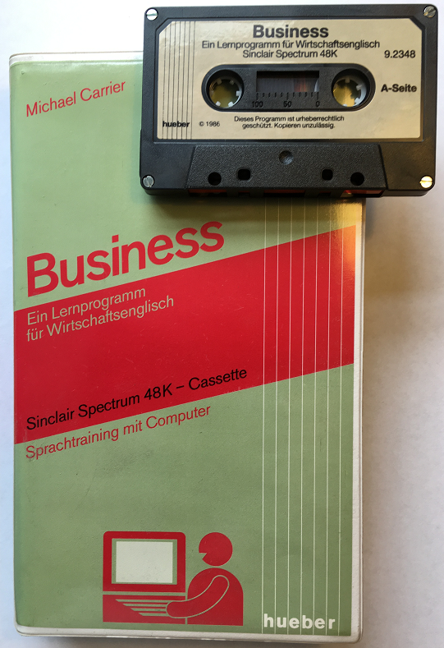
Digital learning is here to stay….
Digital Learning in 1983
Digital learning has been growing in popularity, but the problems of Covid have accelerated the need (and appetite) for virtual, remote and online learning.

Slide 3
Definitions
Digital learning can mean different things:
Online learning any form of learning that takes place wholly or partly online
Elearning an earlier synonym of ‘online learning’, now less commonly used
Blended learning a combination of online learning and teacher-led classroom lessons
Flipped learning key lesson content studied (usually online) before the F2F lesson
Hybrid learning A - a US synonym for ‘blended learning’ AND
B - a mixed model where some of the students are in a classroom, and others are at the same time online and visible on screens in the classroom
Digital only all learning is online; any teacher support is also only online

Slide 4
Digital-only learning pathways: choices
Digital-only - all learning takes place completely online, at a time of the learner’s choosing, and there is little or no teacher input
Digital-first learning, with the majority of learning online but with regular and structured support from an online teacher (and no classroom attendance)
Teacher support: Asynchronous – the learner works independently & a teacher interacts & guides – but not ‘live’.
Teacher support: Synchronous - the learner works independently, but arranges a lesson with a ‘live’ teacher at agreed times. This might even include interactions with other online students (as with Cambridge’s Evolve Digital course)

Slide 5
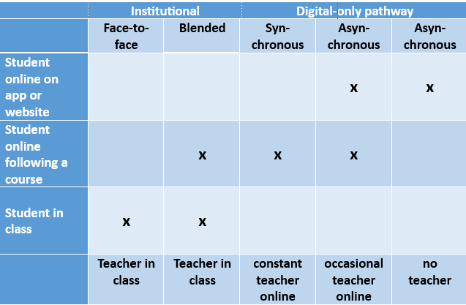
more teacher-mediated
more student-directed / autonomous

Slide 6
Teacher roles
‘‘Teachers need to believe in their own competence - thus self-efficacy - and need to be convinced that digital learning can improve learner outcomes. Training and access to solid research are both important to build this confidence (Petko 2012).
“Technology can uplift and amplify good teaching but it can never improve poor teaching,” he says. “Learning seems to be a social process.” (Schleicher)
‘’Teachers who hold constructivist beliefs about their job (those who see themselves as facilitators of learners' own inquiry) are more likely to understand the pedagogical benefits of using digital learning ‘’(Scottish Government, 2015)

Slide 7
Digital technologies involved
Artificial intelligence (AI)
Machine learning (ML)
Learning Analytics (LA)
Adaptive Learning (AL)
Personalisation
Automated Speech Recognition (ASR)
Speech-enabled translation
Immersive learning (AR & VR)
Digital assessment
Gamification (GBLL)
Robot-assisted (RALL)
Personalisation technologies
Machine learning (ML) Machine learning (ML) is a subfield of AI that uses algorithms trained on data to produce adaptable models that can perform a variety of complex tasks (Coursera, 2023)
Learning Analytics is the process of data collection and analysis.
Adaptive Learning is what educators do with the analysis. AL systems provide branching educational pathways, depending on learners’ prior behaviour and responses, and provide feedback to guide the learner

Slide 8
Benefits of digital learning
Flexibility of time and location
Accessibility of learning – own devices
Autonomy & control over pace, activity
Personalisation - individualised learning
Motivation – e.g. gamification (GBLL)
Increased confidence in learning
Wide range of resources
(Monson 2017, RiseUp 2023)
Notes:
Learners may:
have complex work or family commitments that make it difficult to maintain regular attendance at a classroom course
have had experience of classroom-based learning and found it ineffective, or unmotivating
prefer to learn by themselves rather than with others who they perceive at different levels
already be in a classroom-based course, and wish to add more learning opportunities - more language exposure & ‘time on task

Slide 9
Where is the evidence?
But is digital learning as good as, or better than, face-to-face learning in terms of its impact?
What impact has digital learning had on the learning experience and the learning outcomes of adult language learners?
We look at the research evidence for affective impacts on improving motivation, on learner preferences
We look at the research that provides evidence of quantitative impacts on language proficiency
Meta-analysis of over 100 papers & studies

Slide 10
Key Success Factors
Technology - availability, connectivity, reliability
Design - content, interface, framework
Human - pedagogy, communication, attitude
Support - training, resources, feedback
Evaluation - assessment, usability, quality
(FitzPatrick, 2012)
Notes:
But is digital learning as good as, or better than, face-to-face learning in terms of its impact?
What impact has digital learning had on the learning experience and the learning outcomes of adult language learners?
What is quality
What is success
What is impact

Slide 11
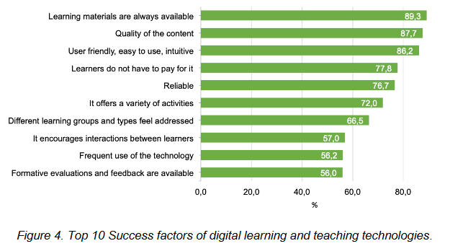
Key success factors
(Faustmann et al, 2019)

Slide 12
What is impact?
Impact in digital learning means that there is a change in the learners’ knowledge or behaviour or competence in language after a learning experience, compared to the state before the learning experience.
It can also be the impact on the ‘whole’ learner – whether they enjoyed the learning experience, found it motivating, easy, difficult etc.
‘’Evaluating the impact of your teaching is about measuring the growth in your students by comparing where they were at an earlier time with where they are now. (Department of Education, Victoria, 2020)

Slide 14
Case Studies - Babbel
‘’Overall 92% of the participants improved their language proficiency.’’ (Vesselinov & Grego, 2016).
‘’86.5% of the respondents saying that they feel a sense of accomplishment when they learn with Babbel….and Babbel gives them more confidence to use a foreign language in real-life situations at work.‘’ (De Oliveira et al. 2021.)
“These results establish that using Babbel can facilitate the development of oral communication skills and not just grammar and vocabulary acquisition, as a previous study had demonstrated. Also, as one might expect, learning gains in terms of oral proficiency, grammar and vocabulary were correlated with the amount of time students invested in using the app. (Loewen et al, 2020)

Slide 15
Case Studies – Rosetta Stone
Rosetta Stone commissioned a study on the effectiveness of their Spanish course, carried out by CUNY (Vesselinov, 2009).
The study found that after 55 hours of study a ‘significant’ proportion of students (56%-72%) increased their oral proficiency by at least one level, achieving the equivalent to one semester a college Spanish course.
BUT: ‘’these initial results indicate that the Rosetta Stone program…..is most likely not capable of replacing the classroom language learning experience. The data presented here provide little evidence to confirm RS’s claims of being superior to in-class learning….In terms of language skills … virtually no conversation takes place through the RS materials, which explains why those participants lacked effective communication strategies’’ (Lord, 2016)

Slide 16
Case Studies - Empower
”Overall it was found that most learners improved their competence by half a CEFR level during the period of the course using one coursebook.
“Attitudes to technology were generally positive, and the online platform and materials were generally seen as easy to use, useful, and motivating.
‘’The Unit Progress Tests, and the personalised practice / feedback loop LOA element, were positively received….with a number of students stating that they liked being able to monitor their own progress and take more control of their own learning.
BUT: ‘’only 3% of learners took the associated competency tests at the middle or end of each learning unit. The Competency Tests / CEFR Report are chronically underused. (Cambridge 2017)

Slide 17
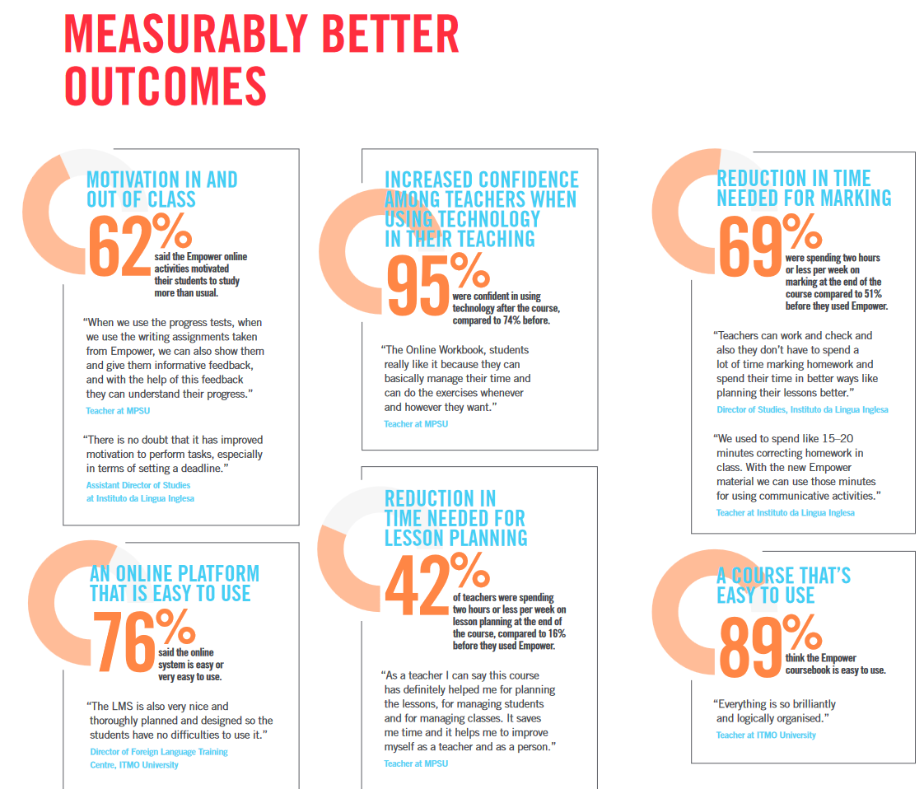

Slide 18
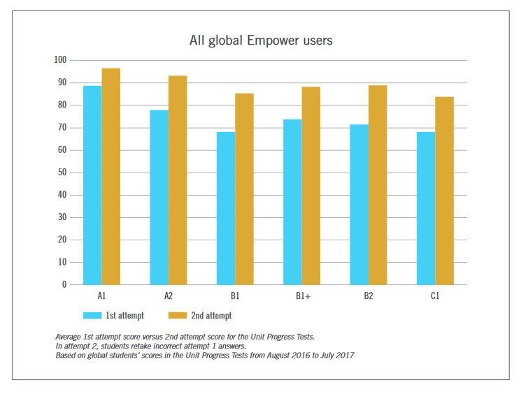
Learning gains from course & personalised practice

Slide 19
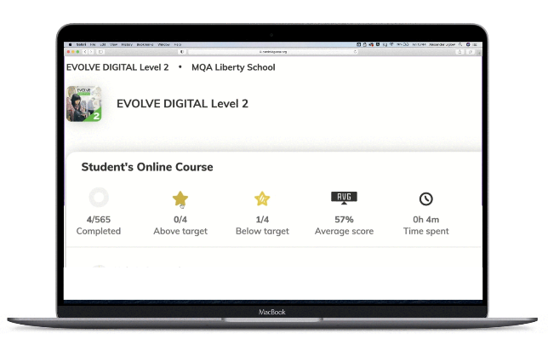
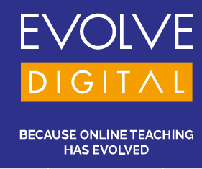
Case Studies: Evolve Digital
Speaking skills at the heart of the course:
Use of speech recognition
Dedicated speaking lessons
Automated speaking activities
Productive speaking tasks that can be recorded and submitted for feedback
“Regardless of where and how they are studying, we know that students consider their ability to speak as evidence of their progress in English. The Student’s Course therefore makes use of the latest speech recognition technology, building students’ confidence to interact in real-world scenarios.”

Slide 20
Evolve Impact Study
Participants
Cohort A: a fully asynchronous self-study course administered without any teacher input
Cohort B: an asynchronous course combined with teacher feedback on Speaking and Writing tasks
Cohort C: an asynchronous course combined with synchronous, teacher-led online classes
Data
The data collection for the evaluation study comprised:
pre- and post-course surveys
pre- and post-course CEPT scores
online classroom observations
teacher interviews
learner analytics data extracted from the course delivery platform

Slide 21
Evolve Impact Study - analysis
Affective perceptions
Learners appreciated an opportunity to revise grammar and vocabulary, learning at one’s own pace, with feedback on Writing and Speaking tasks
Learners found regular online interactions with teachers and fellow participants from different locations helped sustain motivation and engagement, and created an overall positive learning experience.
Learners had positive perceptions of improvement in their Speaking skills and Speaking confidence, perceived effectiveness of digital learning, motivation, as well as interest in and usefulness of the content of the course
Learning gains
51% of participants across all cohorts improved by at least one CEFR level after taking the course
All cohorts had higher post-course scores than pre-course
Some students in Cohorts A and B achieved higher post-course scores compared to Cohort C (who had synchronous teacher lessons)

Slide 22
Evolve Impact Study – wider findings
digital learning can be implemented in a variety of ways and deliver good results – even when doing the course asynchronously without any teacher input
digital learning creates a more positive experience for students when it is delivered with teachers at the centre
affective factors did not always correlate with higher learning gains (in this study)
pre- and post-course tests need to measure speaking to give a clearer picture of learning gains

Slide 23
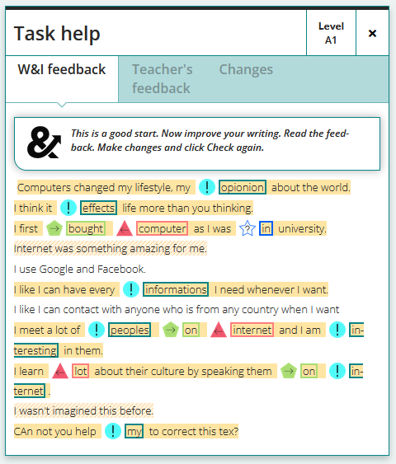
Case Studies: Write & improve
Impact study showed that after using the tools:
students appeared to be more motivated and had a more positive reactions to writing
students demonstrated good writing behaviours which often improved over the course of the study
students attempted tasks multiple times which suggests improved editing, error correction and redrafting processes.
teachers found it encouraged students’ drafting and other macro writing processes
the tool statistics show that there is an overall increase in the students’ writing scores over time
students’ surveys clearly showed more confidence over the pre and post study survey.
Notes:
Mention Speak & Improve – no impact studies yet

Slide 24
Research evidence for impacts: Engagement and motivation
Digital learning improves learners’ motivation and willingness to engage with learning:
‘’The study illustrates that using interactive components of e-learning boosts the motivation of undergraduate students for the learning process” ‘’interactive e-learning features increase undergraduate students’ interest in learning’’
‘’it may help culturally diverse students succeed’’
(Noor et al, 2022)

Slide 25
Language proficiency & competence outcomes
Most of the studies claim that learners ‘feel’ that they have made progress in their language skills, though the amount of progress is not quantified
Some studies offer a more quantifiable gain such as the ability to progress to the next level, or to meet the requirements of an equivalent amount of classroom work , or a change between pre-test and post-test (Edwards & Drew, 2021).
Some claim to show progress on the CEFR scale (Cambridge Empower), others focus on the gains achieved in some skill areas but without significant gains in productive skills (speaking, writing)

Slide 26
Implications for school owners
Develop a Digital Strategy
Do a digital audit & consult all stakeholders
New products with digital options for every class (just like working life)
New course schedules with digital complements or supplements
Deliver, assess, iterate
Improve teacher CPD support
CPD & digital literacy support
Opportunity to design & innovate
Train Learners & clients:
Managing expectations of outcomes
Delighting the customer
“future research might benefit from more controlled designs such as a pre- and post-test design, or a comparison-group design.” (Jiang & Pajak, 2022)
Notes:
Take stock of the current situation and do a digital audit
Consult with stakeholders about their needs & preferences
Design a learning strategy – which modalities, which devices, which timings
Evaluate market for materials (or write new)
Work out how to integrate teacher input (or use Add-on lessons)
Deliver, assess, iterate
conduct a quick survey to understand the current practices and potential barriers to adoption of technology consider how the introduction of technology may affect the interactions among students, teachers, and content. define clear objectives for the education technology, establish ways to regularly assess progress and make course corrections communicate with a range of stakeholders, including teachers, school leaders, parents, and students. explain what technology is and is not supposed to do, how it can be most effectively used

Slide 27
Implications for teachers & trainers
Choose to embrace digital approaches
Ensure access to initial training & regular CPD
Ensure access to Digital literacy support
Focus on self-efficacy & Confidence-building support
Materials development training
Work to train learners in new learning approach, & inspire confidence in digital learning
Motivate and engage learners with interesting and relevant activities
Provide wide range of learner feedback via the technology to demonstrate learning gain

Slide 28
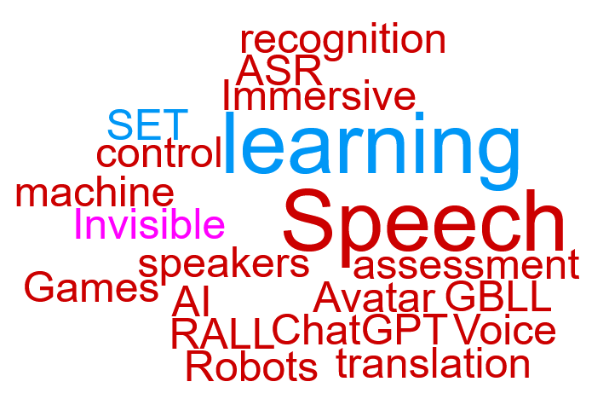
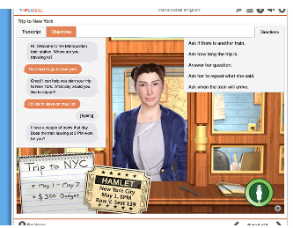
Digital only – what’s next?
Alelo
‘’ Students practice English fluency online with Artificial Intelligence (AI) avatars that mimic the culture, behavior, and gestures of native English speakers. Avatars respond naturally to students, creating authentic conversations with deep language immersion.’’
Speech recognition (ASR)
Speech translation (SET)
Voice control
Immersive learning
Games (GBLL)
Robots (RALL)
ChatGPT
AI – machine learning
Avatar speakers
Invisible assessment
Notes:
Speech recognition (ASR)
Speech translation (SET)
Voice control
Immersive learning
Games (GBLL)
Robots (RALL)
ChatGPT
AI – machine learning
Avatar speakers
Invisible assessment

Slide 29
Takeaways
Clear evidence that Digital Learning improves learner outcomes, especially in the area of affective outcomes
Clear evidence that it increases time on task and self-perception of confidence and autonomy
Clear evidence that teacher support, even if only online, aids learner outcomes
Clear evidence of improvements in learner proficiency, including in productive skills

Slide 31
References
See bibliography on my website
www.michaelcarrier.com
Presentation slides:
www.michaelcarrier.com
Comments:
michael@mcarrier.co.uk

